Slide 1

Employee Attrition Analysis for
Green Destination
Suhani A Subash

Slide 2
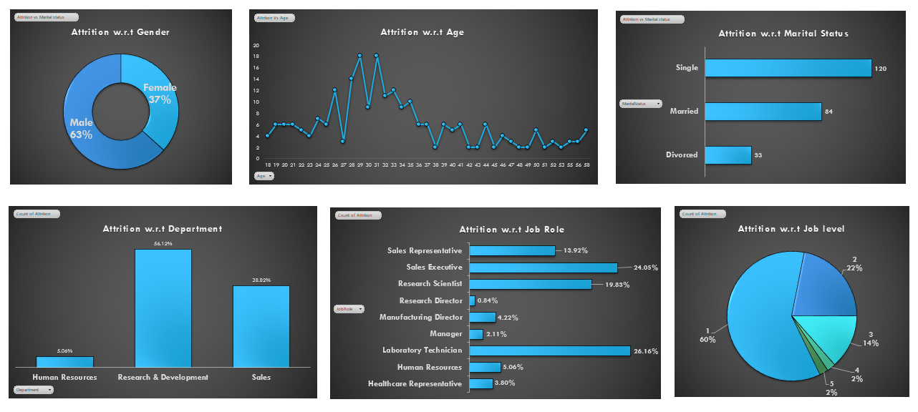
Dashboard

Slide 3
Objective
Green destinations is a well known travel agency. The HR Director has recently notices an increase in employees leaving (attrition) She would like to figure out any patterns or trends. She has surveyed the staffs of Green Destinations and here is the data

Slide 4
“Attrition Analysis by Gender”
“Out of the attrition, 63% are Male and the rest, i.e., 37% are Female.”

Slide 5
"Attrition Analysis by Age"
“The highest attrition rates are seen among employees aged 28 to 33.”

Slide 6
“Attrition Analysis by Marital Status”
“Single employees show the highest attrition, followed by married individuals.”

Slide 7
“Attrition Analysis by Department”
“Research & Development department faces the highest attrition, followed by Sales.”

Slide 8
“Attrition Analysis by Job Role”
“Sales Representatives and Research Scientists have the highest attrition rates.”

Slide 9
“Attrition Analysis by Job Level”
“Lower job levels have higher attrition, indicating possible dissatisfaction among entry-level employees.”

Slide 10
Conclusion
Focus on retaining male employees and those aged 28-33 by addressing specific challenges they may face.
Implement initiatives that improve work-life balance and provide career development opportunities for single employees.
Conduct detailed surveys or focus groups within the R&D and Sales departments to understand and address the root causes of attrition.
Offer clear career progression paths, mentoring programs, and skill development opportunities to reduce attrition among entry-level employees.

